Slide 1
What's In Your Hand?
Dr. Patrick Pang, Great Commission International Partnerships Uploaded by Dr. Rick Griffith, Crossroads International Church Singapore cicfamily.com & BibleStudyDownloads.org

Slide 2
Did You Know…
There are:
40 verses | Baptism
275 verses | Prayer
350 verses | Faith
650 verses | Love
2,350 verses | Finances & Material Possessions
- Crown Ministries

Slide 3
I. God Owns Everything
"Everything in heaven and earth is Yours...
wealth and honor come from You;
You are the ruler of all things."
— 1 Corinthians 4:2 (NCV)

Slide 4
You are the trustee, manager, and steward of 100% of what God entrusts to you.
"Those who are trusted with something valuable must show that they are worthy of that trust."
1 Corinthians 4:2 (NCV)

Slide 5
He is no fool who gives what he cannot keep to gain that which he cannot lose.
- Jim Elliot

Slide 6
"A candle that lights another candle loses nothing."
- President Thomas Jefferson

Slide 7
What's In Your Hand?

Slide 8
David

Slide 9
What's In Your Hand?

Slide 10
A little boy

Slide 11
5 loaves and 2 fish

Slide 12
Until and unless you release that which is in your hand, and place them in the hands of Jesus,
NOTHING HAPPENS!

Slide 13
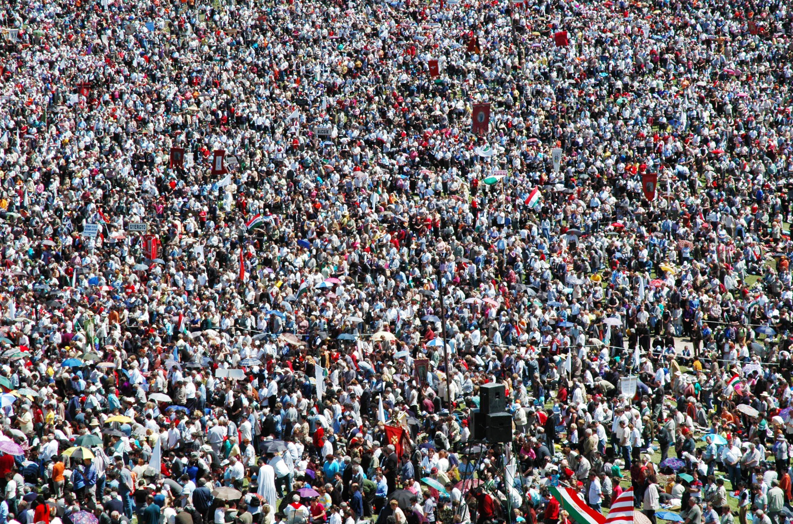
5000 men, not counting women and children.
- John 6; Matt. 14:21

Slide 14
"How will we feed all these people?"
- John 6:5

Slide 15
When God asks a question,
He is not looking for information.
— John 6:6

Slide 16
Everything's a liability.
The only asset is a little boy.

Slide 17
5 loaves and 2 fish
"But what are they among so many?" – John 6:9

Slide 18
The disciples saw DEMAND,
but Jesus saw SUPPLY.

Slide 19
"Jesus gave thanks."
— John 6:11,23

Slide 20
"Trust in yourself and you are doomed to disappointment. Trust in your friends and they will die and leave you. Trust in your money and you may have it taken away from you. Trust in your reputation and some slanderous tongue may blast it. But trust in God and you are never to be confounded in time and eternity."
– Dwight L. Moody

Slide 21
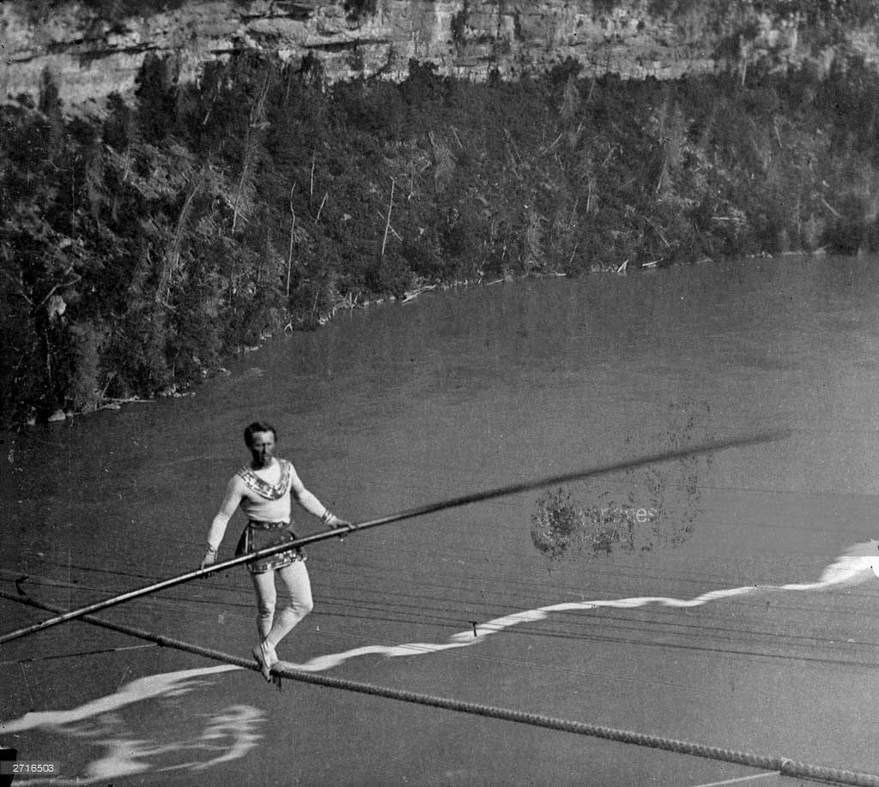
Charles
Blondin

Slide 22
Black

Slide 23
NT Preaching link at BibleStudyDownloads.org
Get this presentation and script for free!
Notes:
NT Preaching (np)

